Slide 1
Motion Estimation

Slide 2
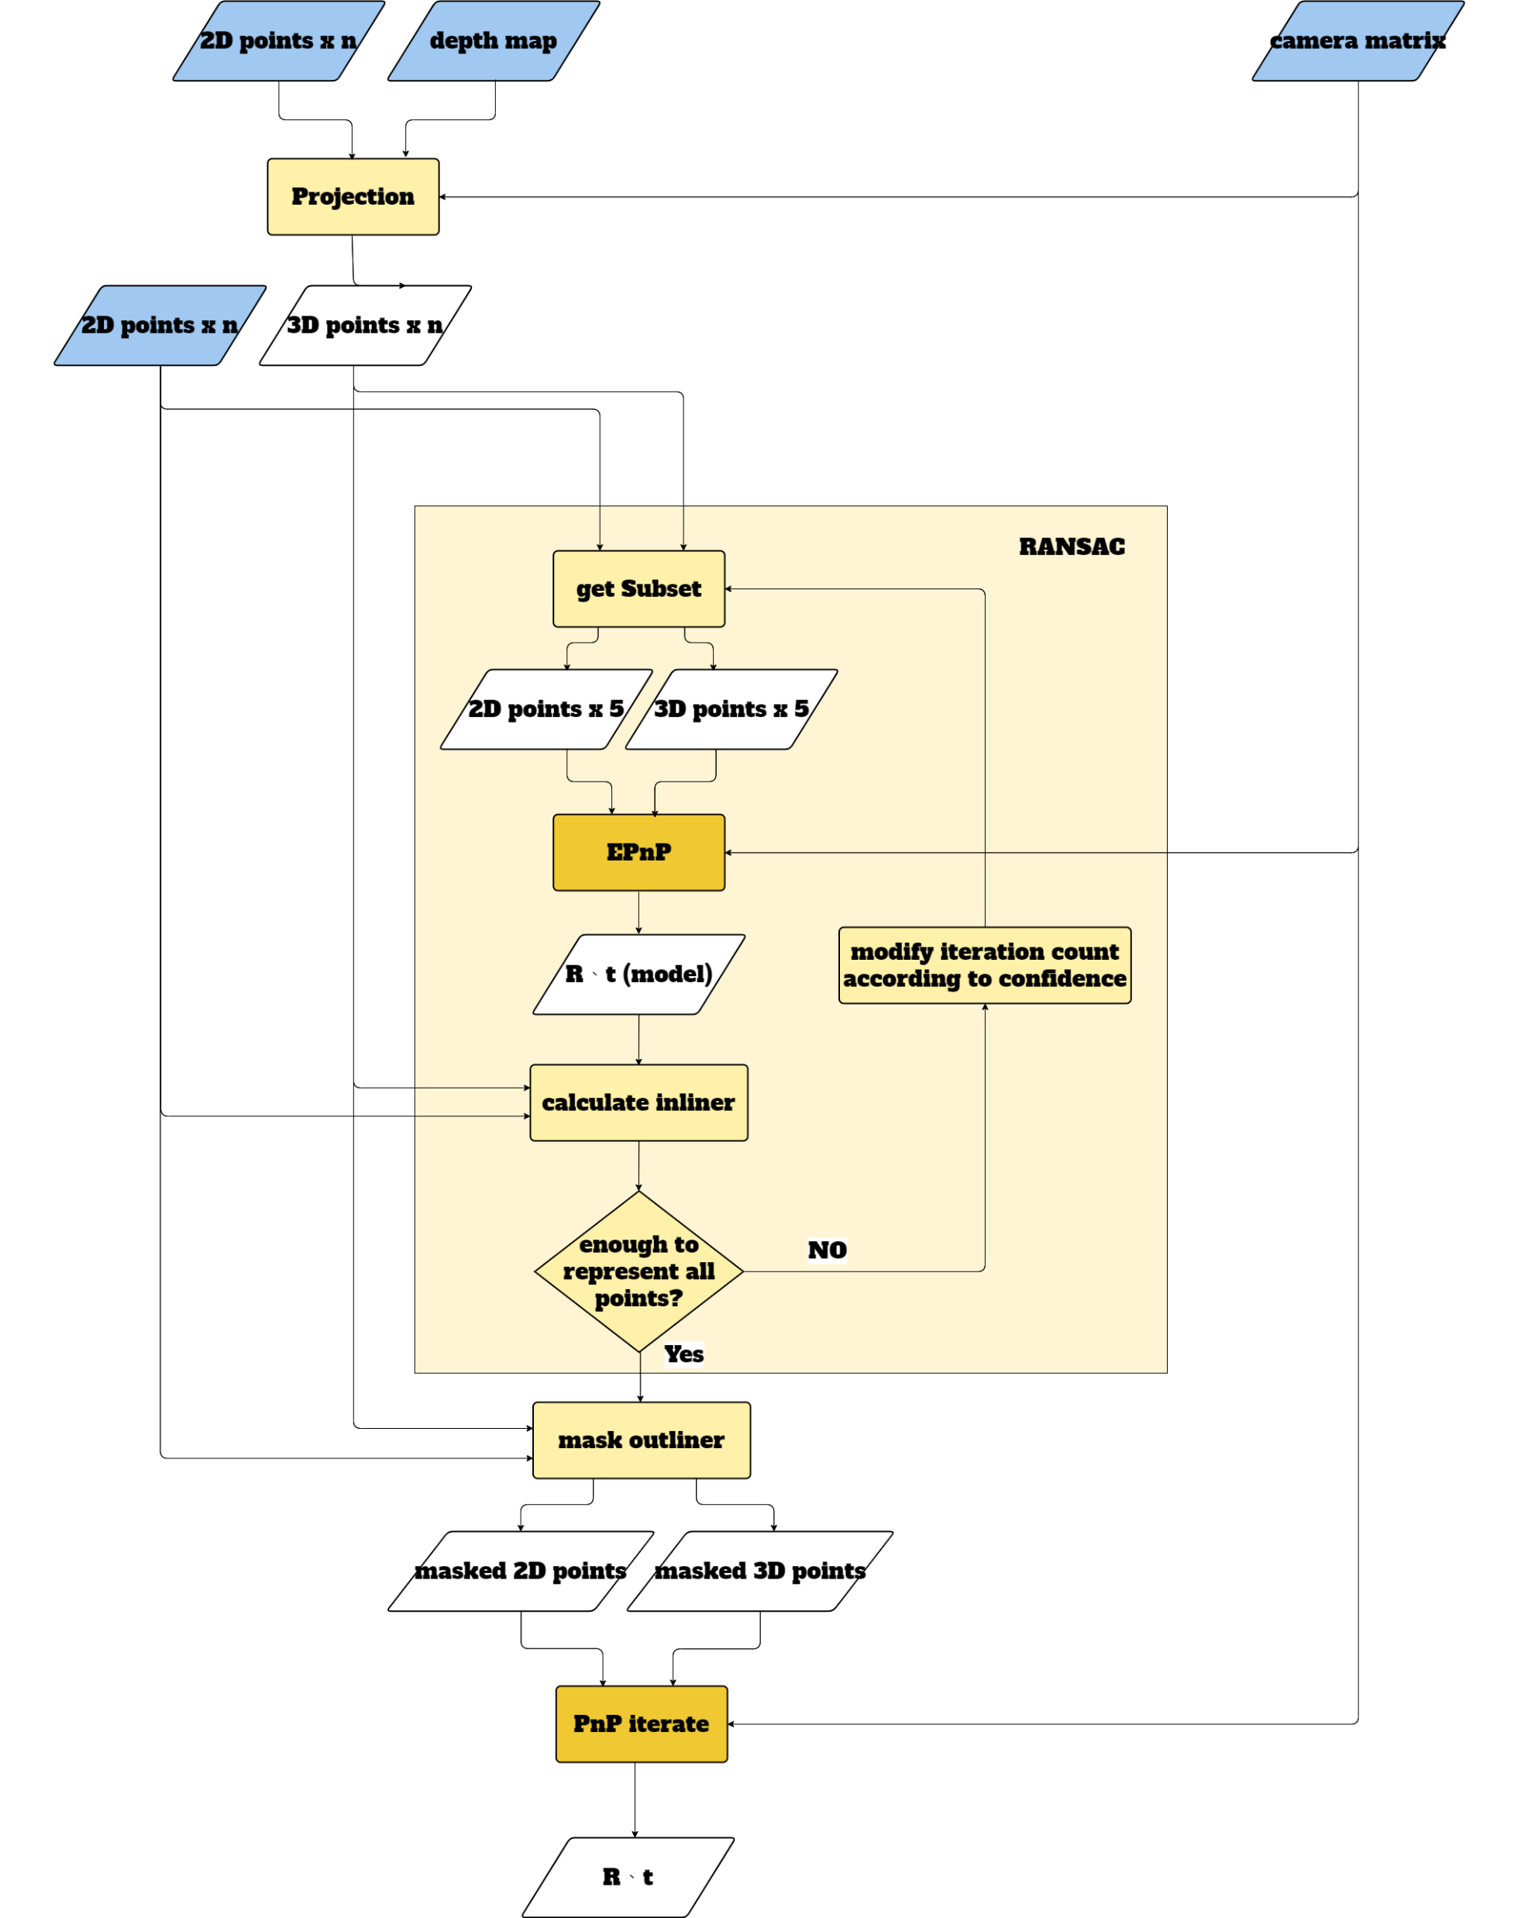
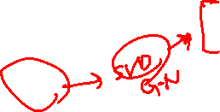
Overview:
2D -> 3D
RANSAC+
EPnP
Need 2D、3D points
To many points
Which points are representative?
Need 2D、3D points
目標

Slide 3

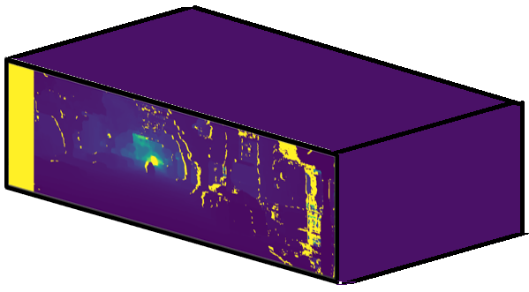
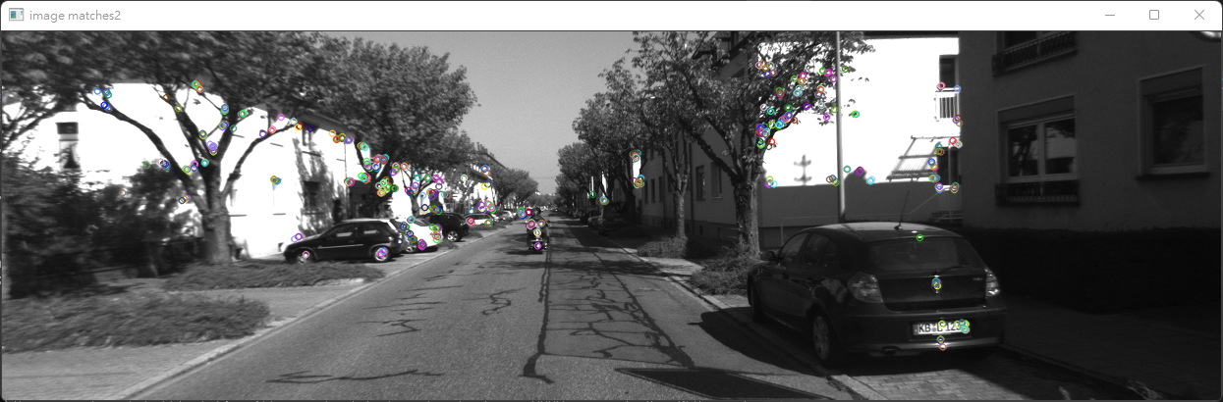

What we have:
Project 2D to 3D points:
depth keypoints1、keypoint2 camera matrix
(match)

Slide 4

Project 2D to 3D points:
keypoints1 + depth = object points
(2D) (3D)

Slide 5
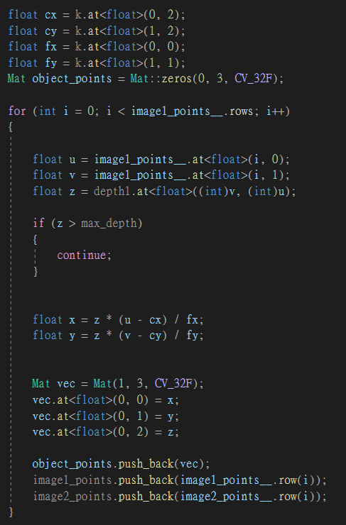
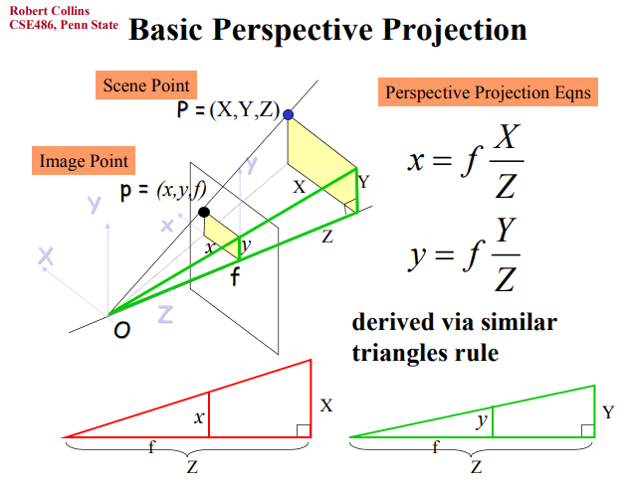
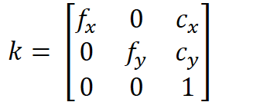
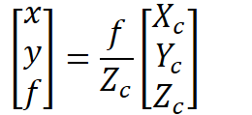
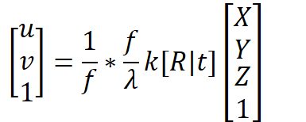
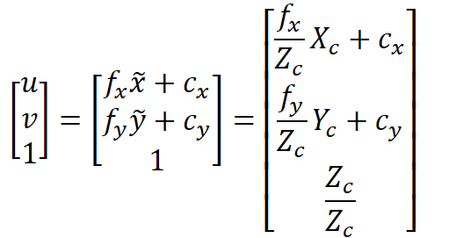
Project 2D to 3D points:

Slide 6

RANSAC + EPnP:

Slide 7
RANSAC :

Slide 8

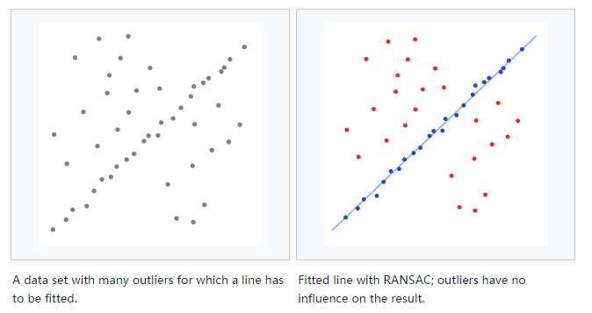
RANSAC :
N = 30
#inliner = 20
C(n, 2) How many time?
#inliner = 25
#inliner = 12
Given confidence 60%
If #inlier / N > 60%, stop

Slide 9

RANSAC :
1. subset
2. model
3. Threshold to calculate inlier
4. Confidence to tell when to stop

Slide 10
RANSAC :
random取一組match做epnp
得到R1、t1

Slide 11
RANSAC :
用得到的R1、t1
對其他object points做投影

Slide 12
RANSAC :
用得到的R1、t1
對其他object points做投影

Slide 13
RANSAC :
用得到的R1、t1
對其他object points做投影

Slide 14
RANSAC :
用得到的R1、t1
對其他object points做投影

Slide 15
RANSAC :
用得到的R1、t1
對其他object points做投影

Slide 16
RANSAC :
用得到的R1、t1
對其他object points做投影

Slide 17
RANSAC :
用得到的R1、t1
對其他object points做投影

Slide 18
RANSAC :
Given threshold
區分出inlier、outlier
i.e. |真實2Dpoint – 投影2D point| < threshold
#outlier1 = 2

Slide 19
RANSAC :
重複取Ri、ti

Slide 20
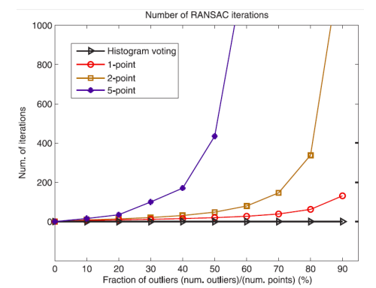
RANSAC :
根據confidence減少iteration:
P = #inlier / N
P^{N}: N個點都是inlier
1- P^{N}: 至少1個點是outlier
(1- P^{N}) ^{k}: 做到k次後，不論怎麼做都不成功 = 1 – confidence
1 – confidence = (1- P^{N}) ^{k}
Log(1 – confidence) = k*Log(1- P^{N})
k = Log(1 – confidence) / Log(1- P^{N})
=> Iteration可減少為k

Slide 21
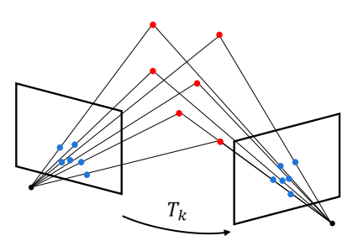
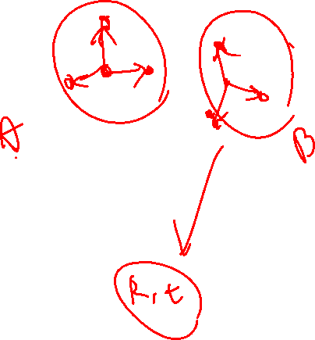
PnP :

Slide 22
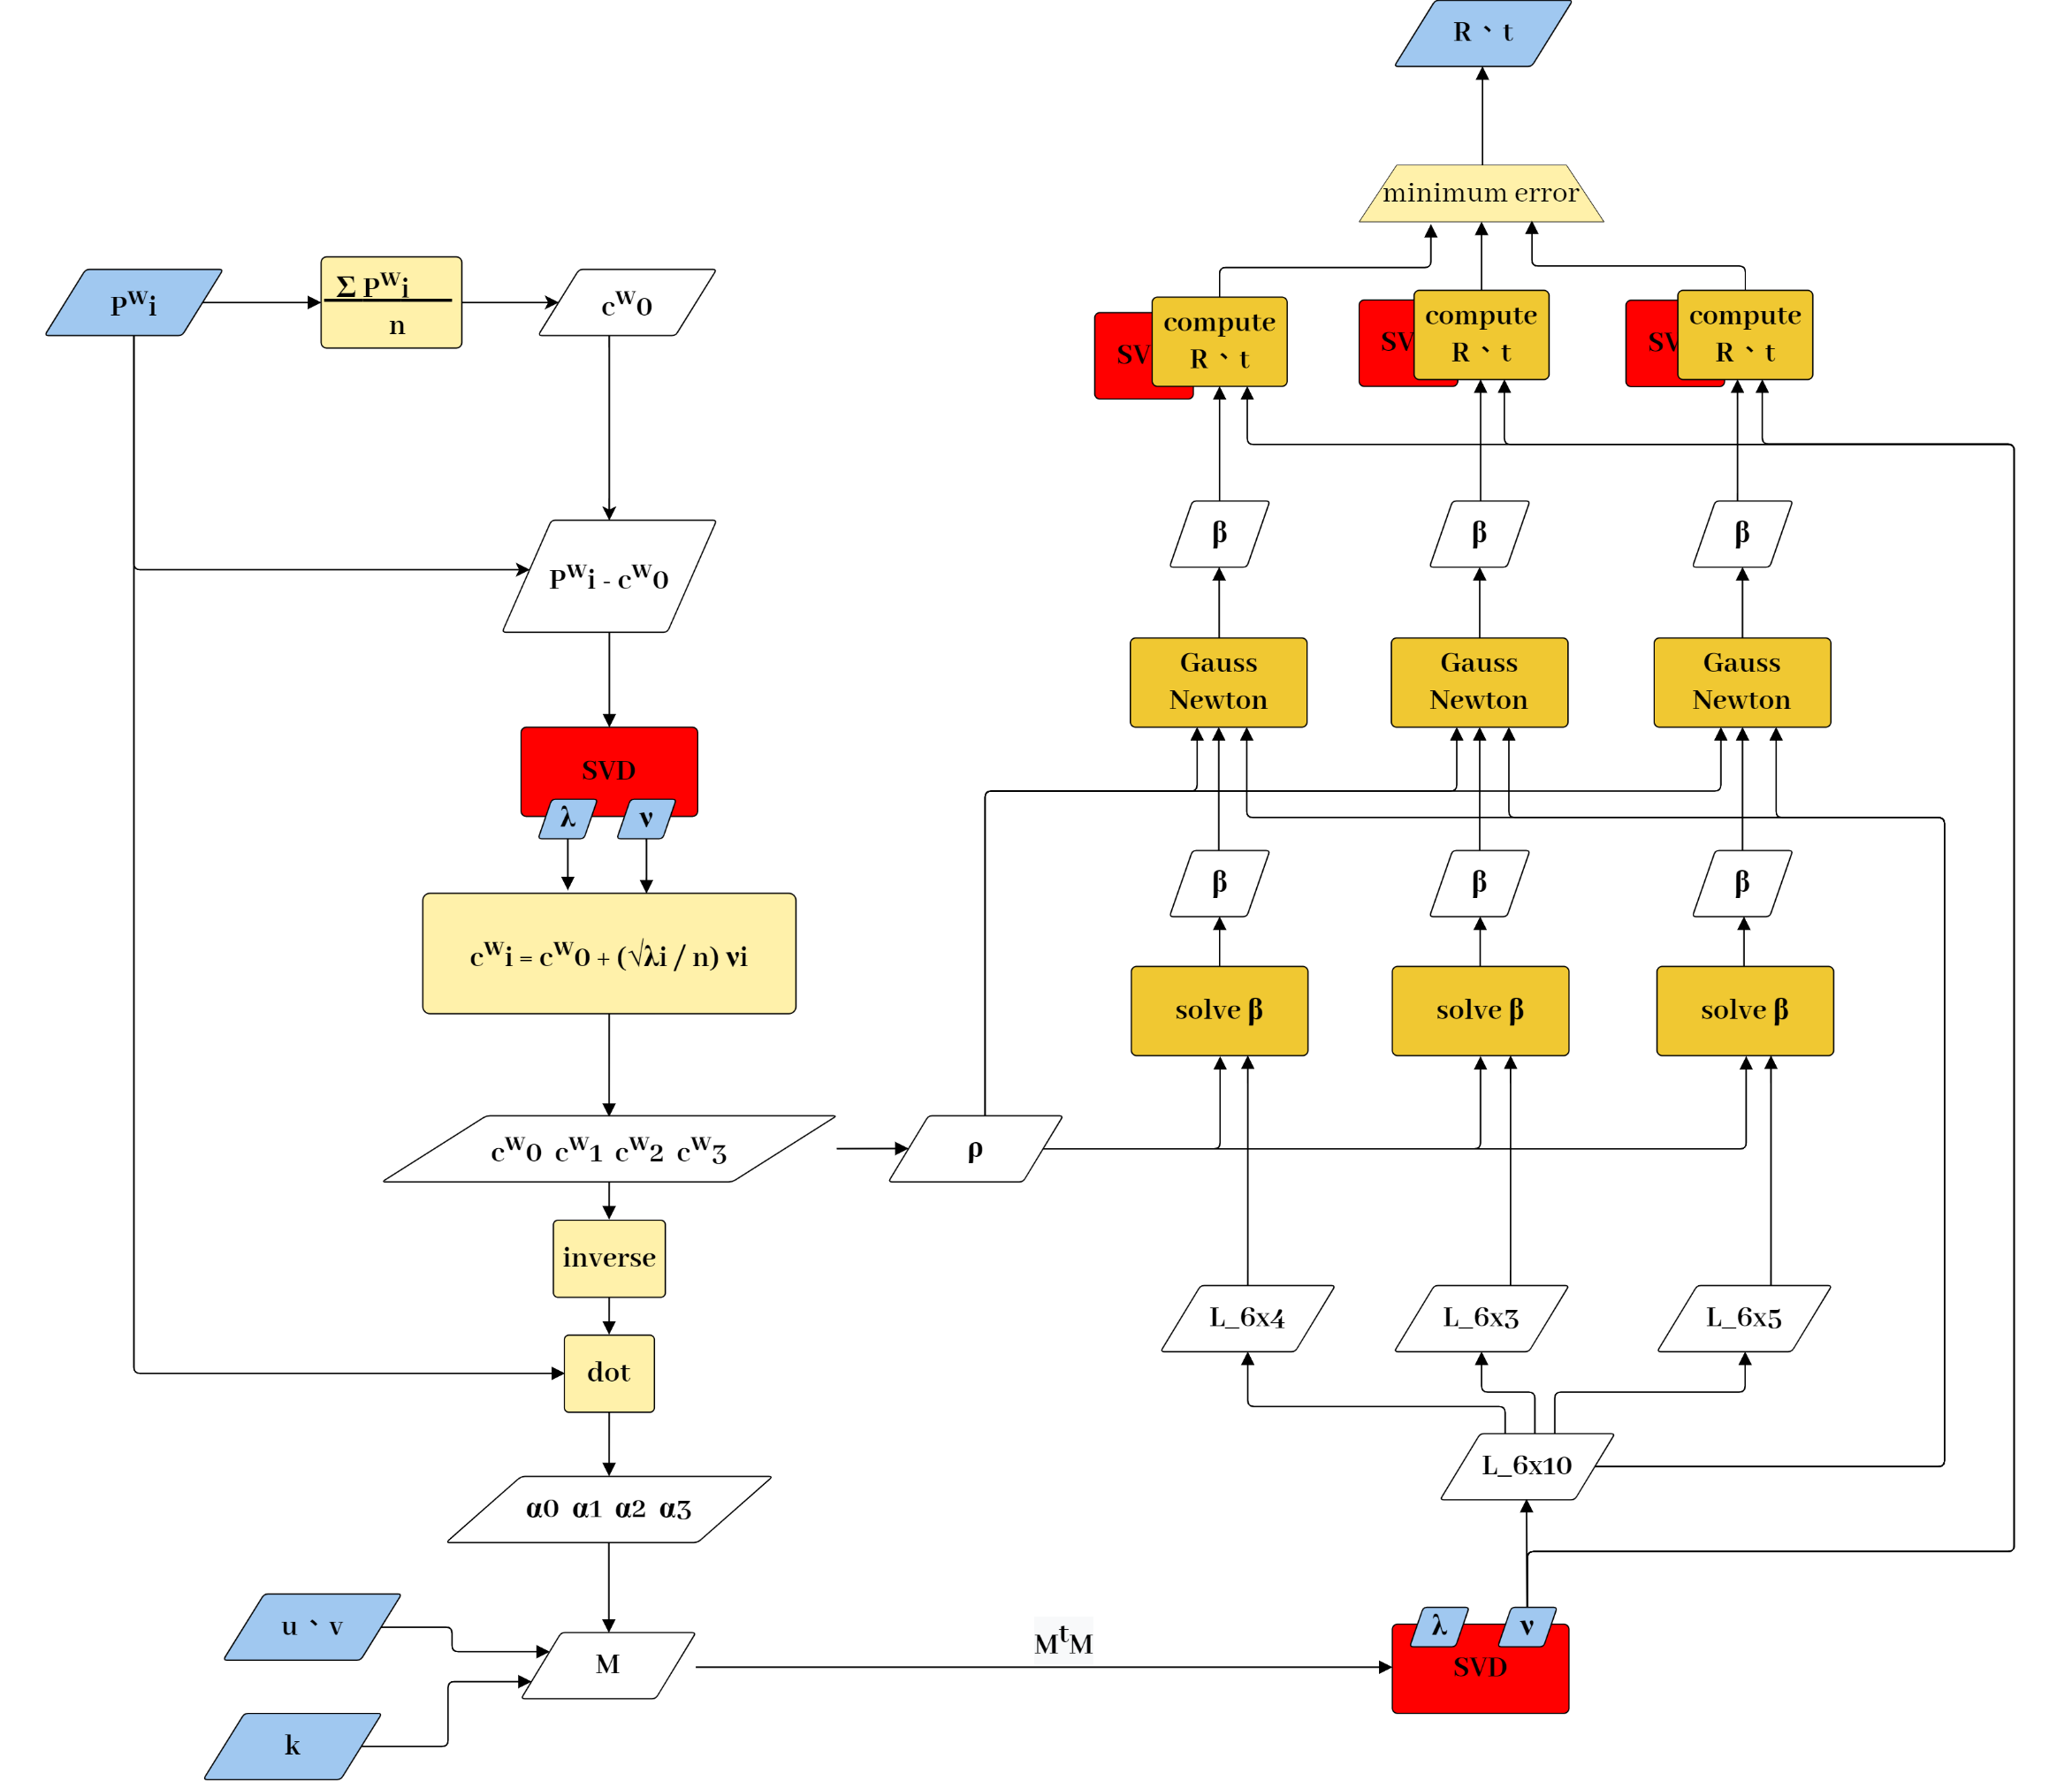
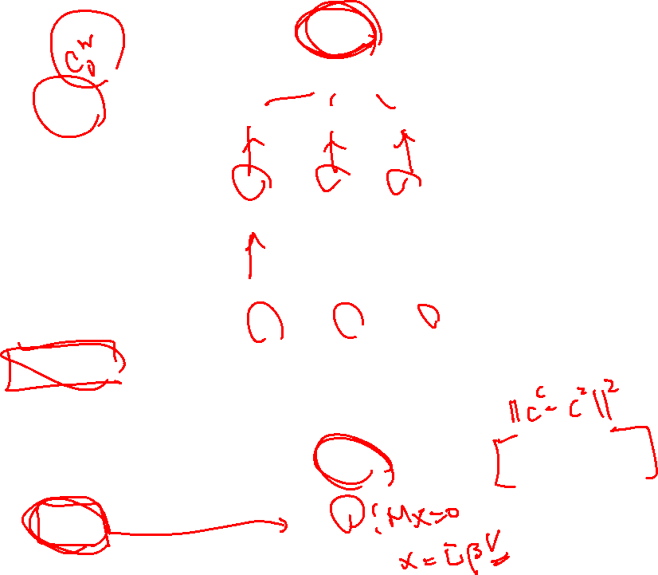
EPnP :

Slide 23
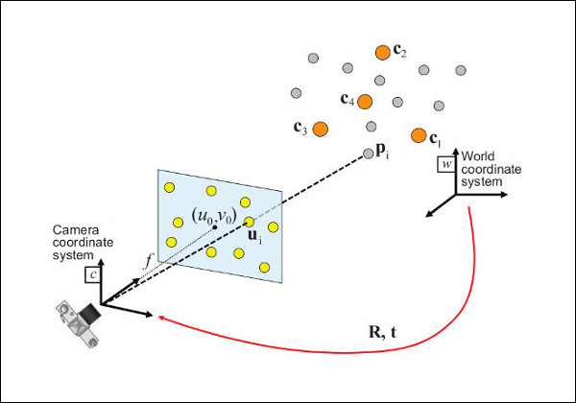
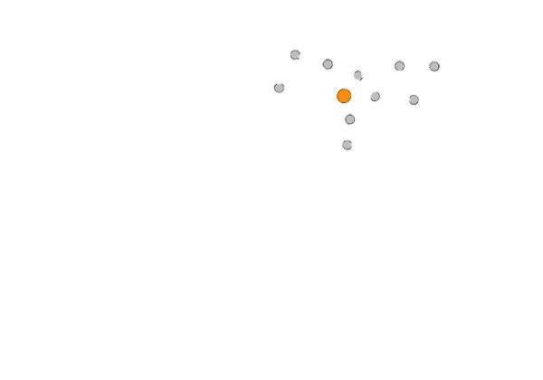
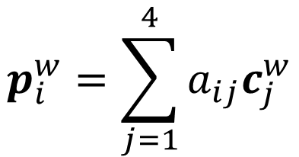

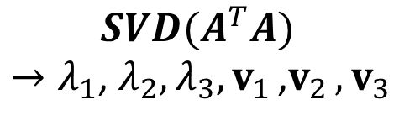
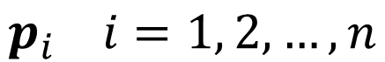
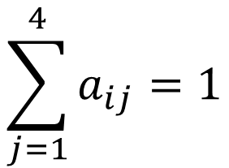

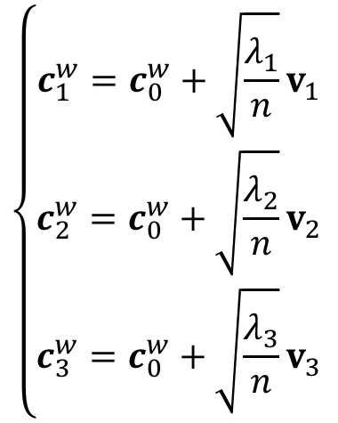
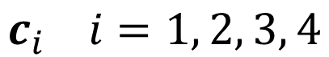
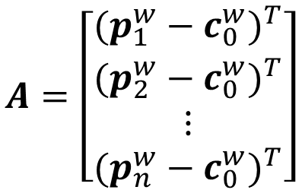
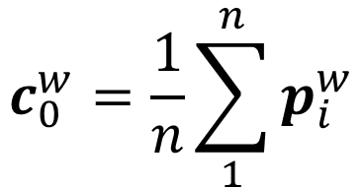
EPnP :
$$p_{i}^{w}=\sum_{j=1}^{4}{a_{ij}c_{j}^{w}}$$
$$\sum_{j=1}^{4}{a_{ij}=1}$$
$$p_{i} i=1, 2, …, n$$
$$c_{i} i=1, 2, 3, 4$$
$$A=\left[\begin{matrix}\begin{matrix}(p_{1}^{w}−c_{0}^{w})^{T} \\ (p_{2}^{w}−c_{0}^{w})^{T}\end{matrix} \\ \begin{matrix}⋮ \\ (p_{n}^{w}−c_{0}^{w})^{T}\end{matrix}\end{matrix}\right]$$
$$c_{0}^{w}=\frac{1}{n}\sum_{1}^{n}{p_{i}^{w}}$$
$${SVD(A}^{T}A)$$
$→λ_{1}$, $λ_{2},λ_{3}, v_{1 }$,$v_{2 },v_{3}$
$$\left\{\begin{aligned}c_{1}^{w}=c_{0}^{w}+\sqrt{\frac{λ_{1}}{n}}v_{1 } \\ c_{2}^{w}=c_{0}^{w}+\sqrt{\frac{λ_{2}}{n}}v_{2 } \\ c_{3}^{w}=c_{0}^{w}+\sqrt{\frac{λ_{3}}{n}}v_{3 }\end{aligned}\right.$$

Slide 24
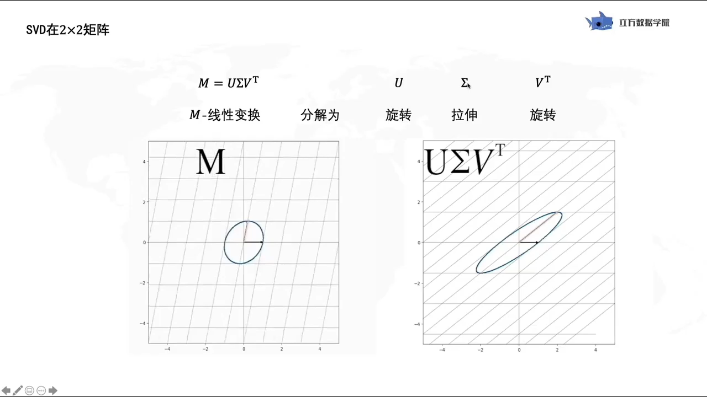
SVD 分解 :
旋轉
拉伸
旋轉

Slide 25
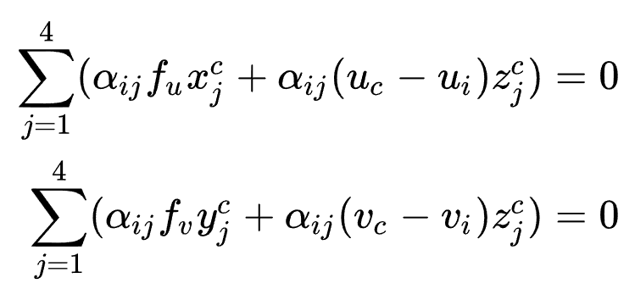
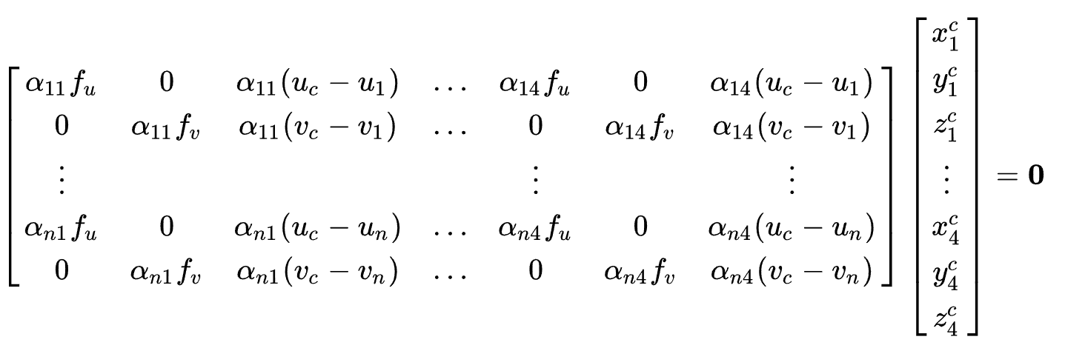
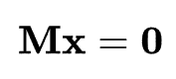
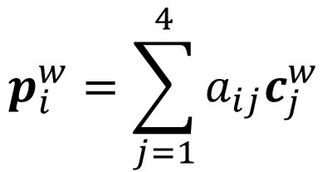

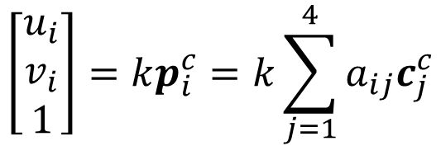
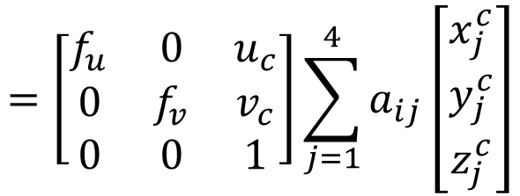
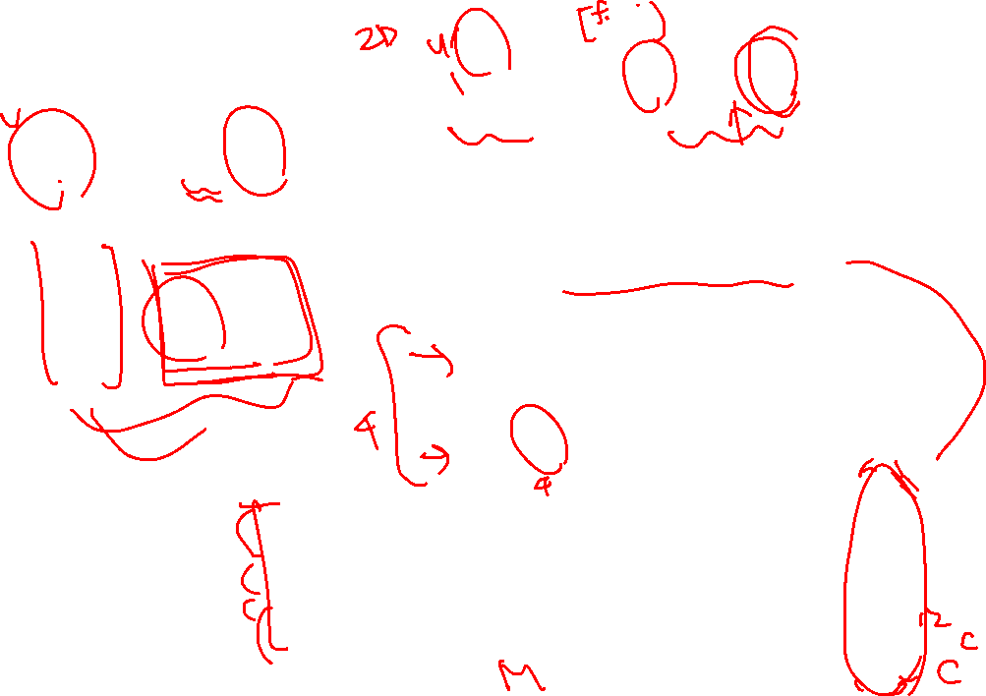
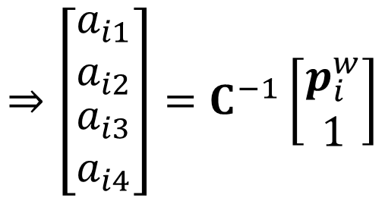
EPnP :
$$\left[\begin{matrix}u_{i} \\ v_{i} \\ 1\end{matrix}\right]=kp_{i}^{c}=k\sum_{j=1}^{4}{a_{ij}c_{j}^{c}}$$
$$p_{i}^{w}=\sum_{j=1}^{4}{a_{ij}c_{j}^{w}}$$
$$=\left[\begin{matrix}f_{u} & 0 & u_{c} \\ 0 & f_{v} & v_{c} \\ 0 & 0 & 1\end{matrix}\right]\sum_{j=1}^{4}{a_{ij}\left[\begin{matrix}x_{j}^{c} \\ y_{j}^{c} \\ z_{j}^{c}\end{matrix}\right]}$$
$$⇒\left[\begin{matrix}\begin{matrix}a_{i1} \\ a_{i2}\end{matrix} \\ \begin{matrix}a_{i3} \\ a_{i4}\end{matrix}\end{matrix}\right]=C^{−1}\left[\begin{matrix}p_{i}^{w} \\ 1\end{matrix}\right]$$

Slide 26
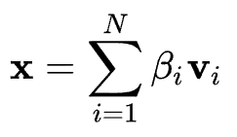
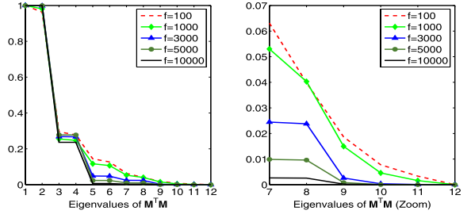
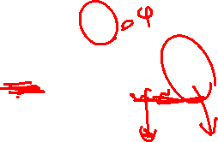
EPnP :

Slide 27
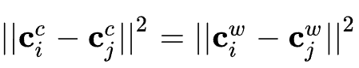
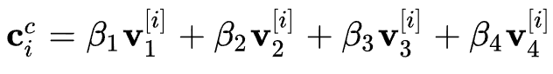
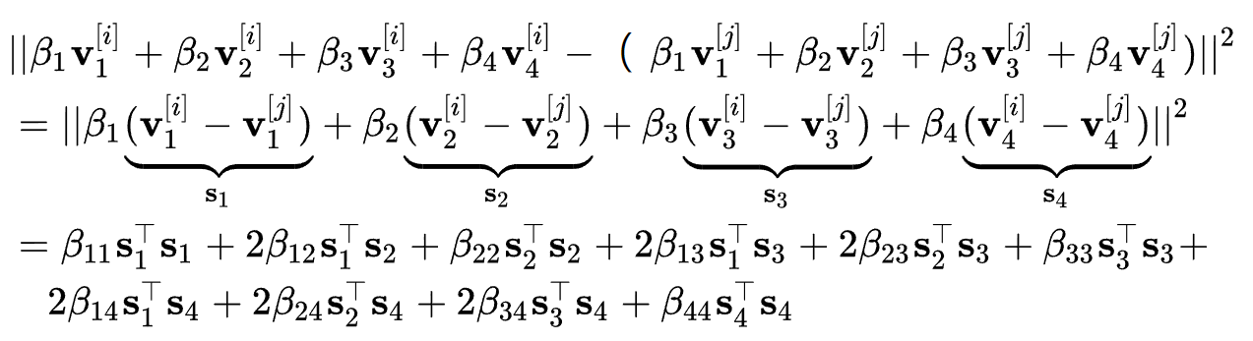
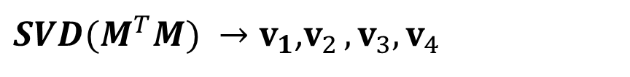
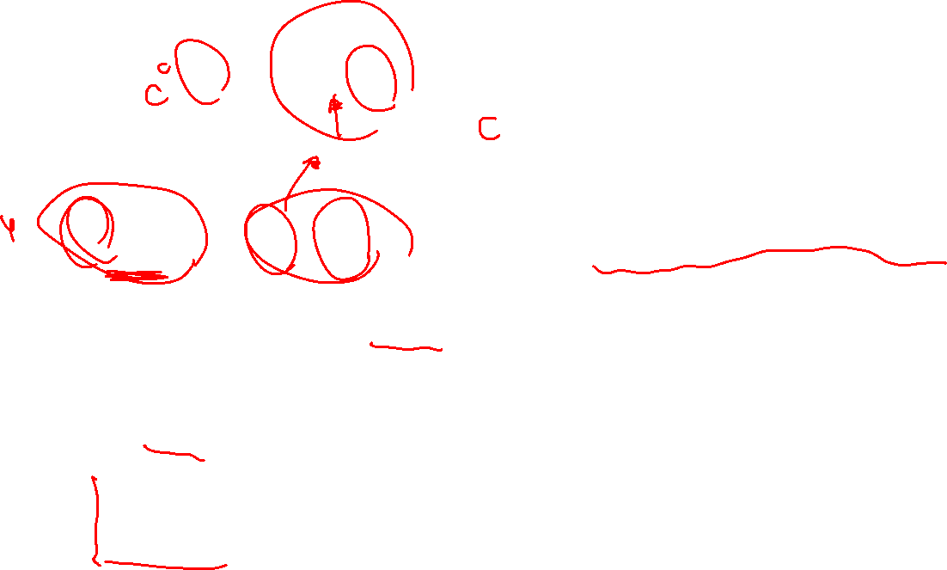
EPnP :
${SVD(M}^{T}M) →v_{1}$,$v_{2 },v_{3},v_{4}$

Slide 28
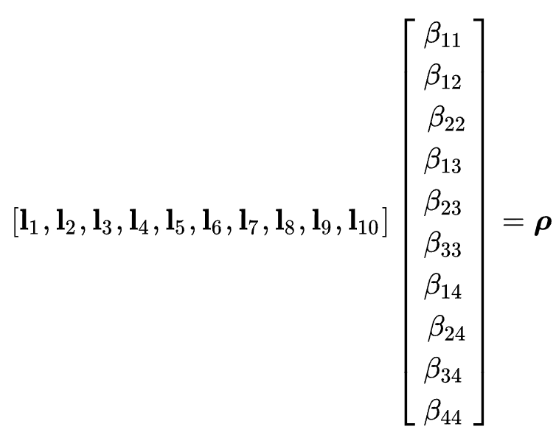
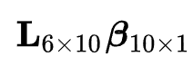
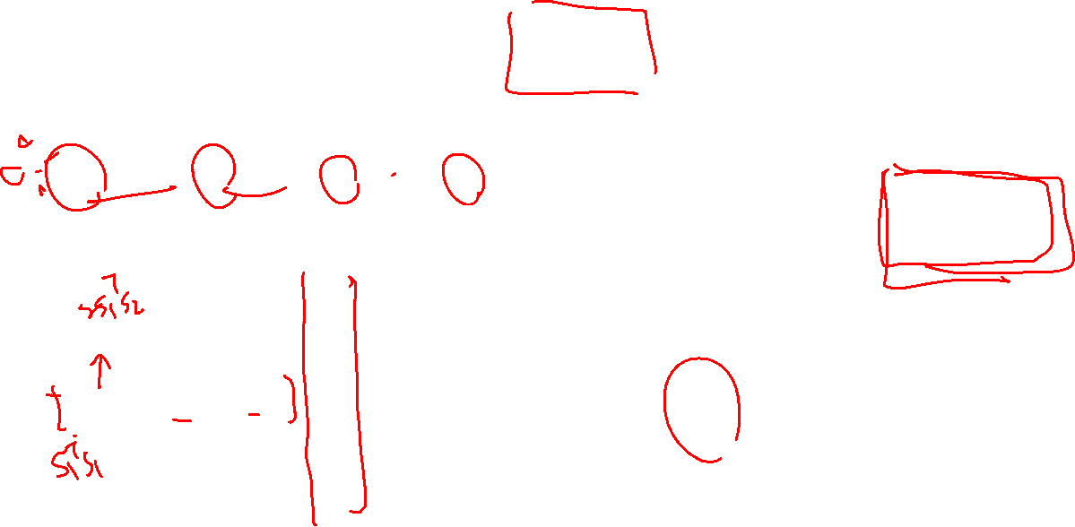
EPnP :

Slide 29
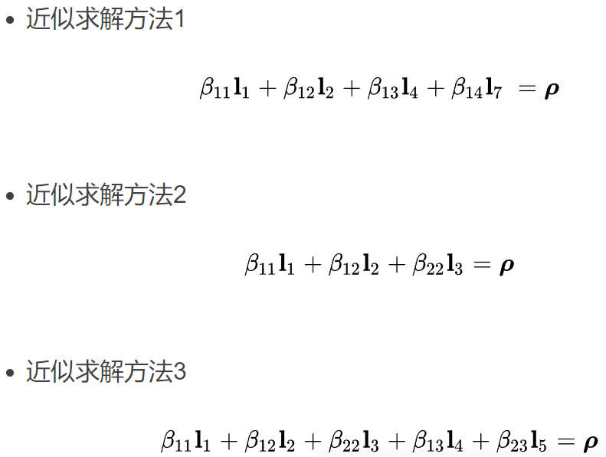
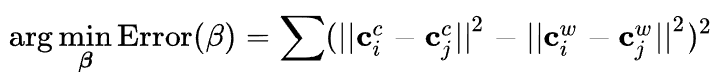
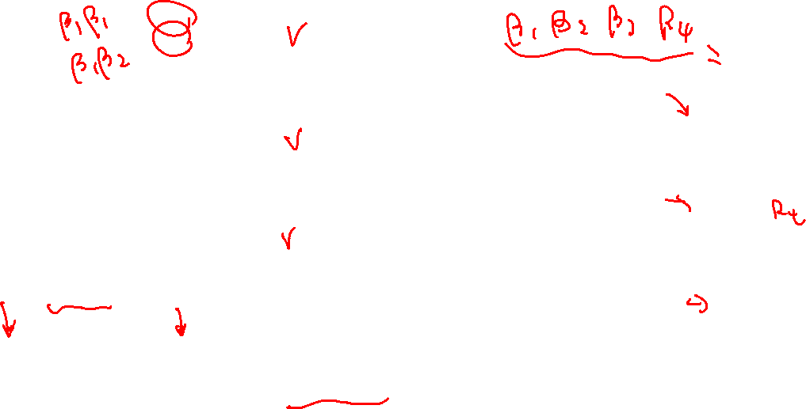
EPnP :

Slide 30
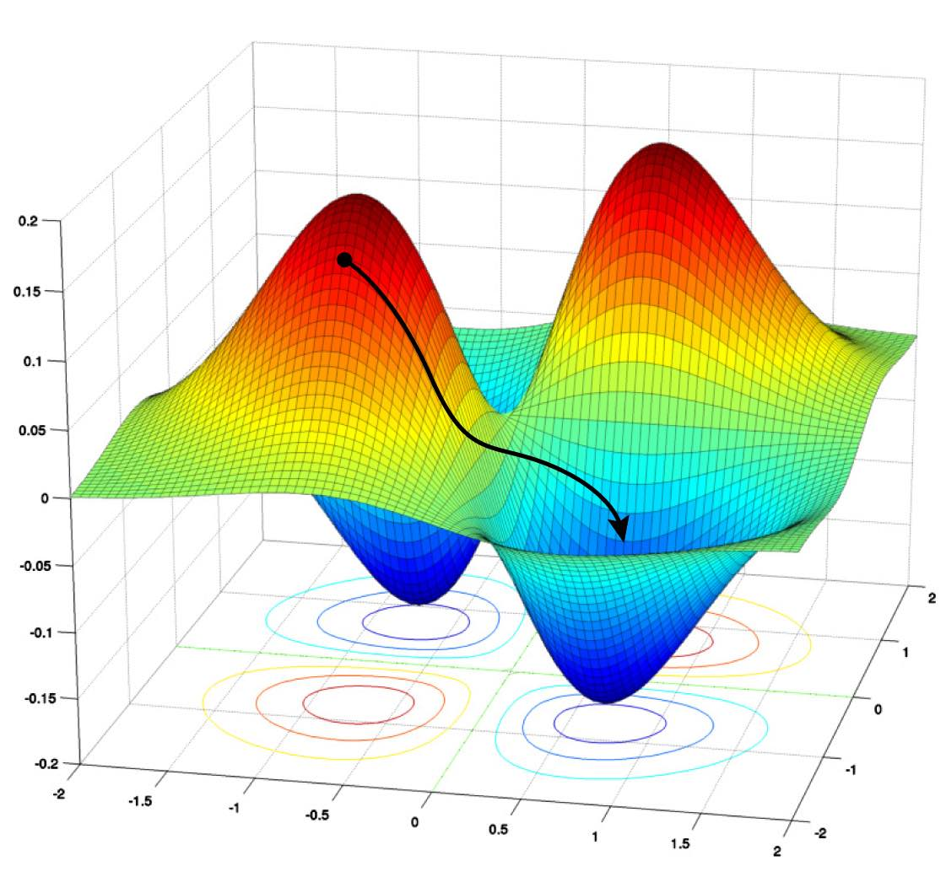






EPnP : Gauss Newton

Slide 31










EPnP : Calculate R、t
$${SVD(H}^{T}H)$$

